Slide 1


Slide 2

Agenda
Convention: CactusCon
Lab
https://blueteamlabs.online/home/challenge/29
Tools
Questions?

Slide 3

Convention: CactusCon
Local? Free? Why not both?
February 4-5, 2022
7 days!
In place of next weeks workshop
Mesa, AZ
Talk Schedule out now (#resources)

Slide 4

Lab @ https://blueteamlabs.online
Linux or windows (preferably Linux)
https://blueteamlabs.online
Under ‘Challenge’ tab, Search ‘Shiba Insider’
https://blueteamlabs.online/home/challenge/29
https://blueteamlabs.online/home/challenge/29
Look for the Story
How does blank data fit into the bigger picture?

Slide 5
Tools
Wireshark
Cyberchef
Steghide
Exiftool

Slide 6

What is Wireshark?
Free and open-source packet analyzer
Easy to introduce, difficult to master
Use OSI model to determine where different data would be stored in a packet

Slide 7
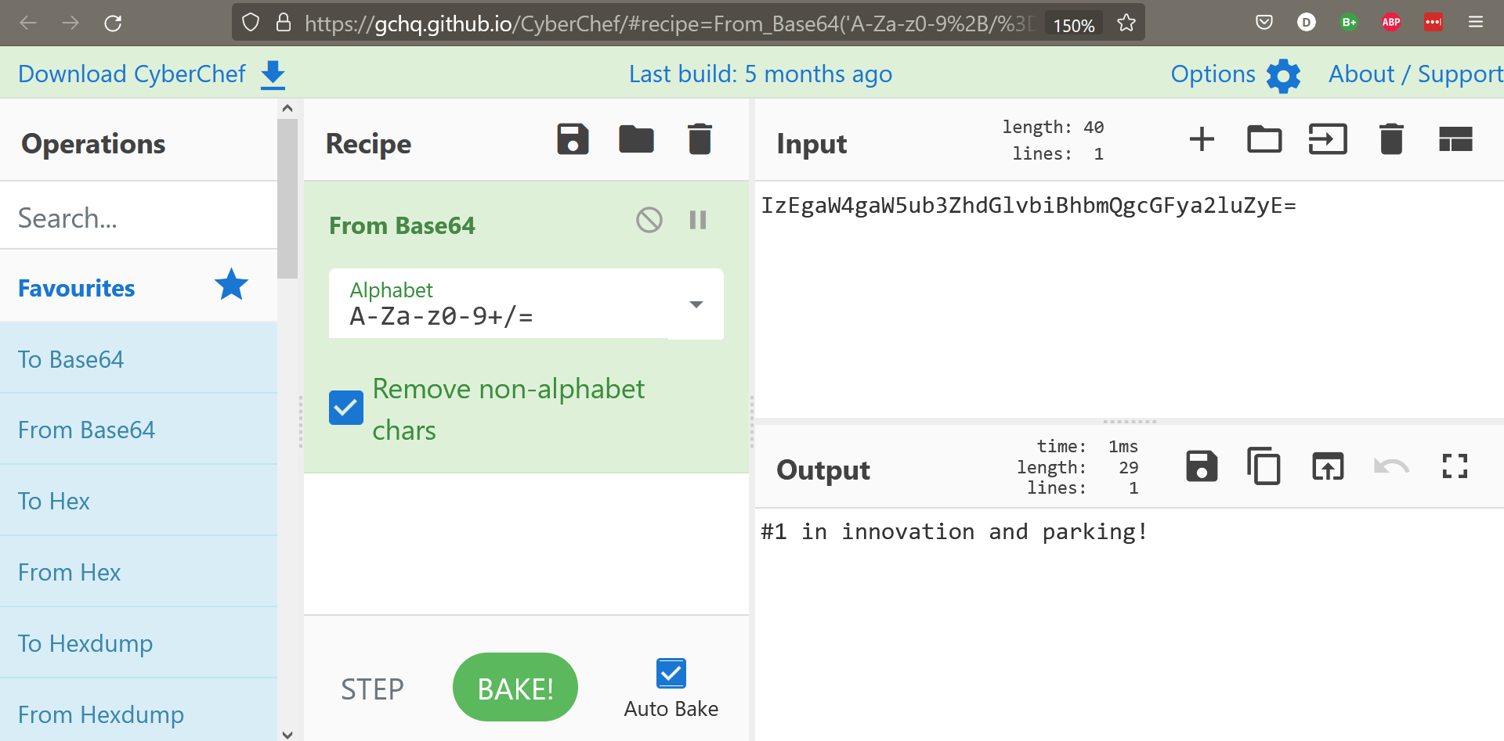
Cyberchef
https://gchq.github.io/CyberChef/

Slide 8
Exiftool
Exiftool <filename>
Exiftool sparky.jpg

Slide 9
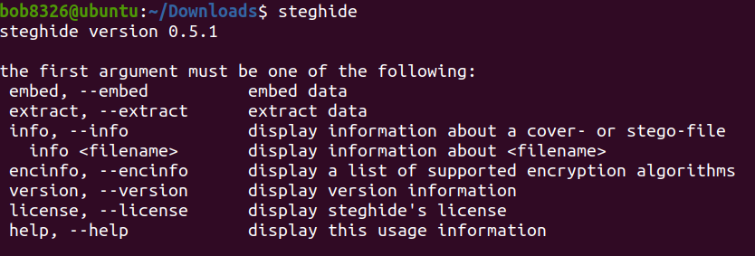
Steghide: General info

Slide 10
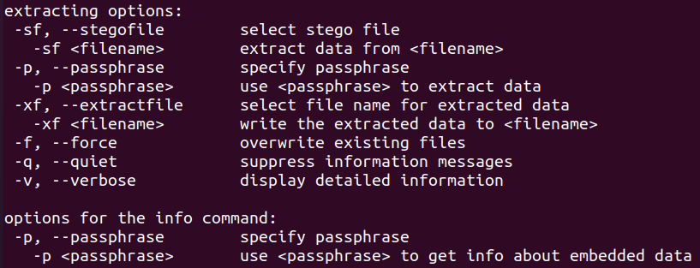
Steghide: Extracting options

Slide 11
Free bread crumb
The hostile actor will be identified by their btlo profile

Slide 12

Questions?

